Slide 1

DETECTION OF STRESS IN HUMANS FROM VOICE

Slide 2
PARTICIPANTS:
MUKESH.K
SUBHASREE.B
ROKHINI.V
VAISHANAVADEVI.B
INSTITUITION:
Puducherry Technological University(PTU)
MENTOR:
Dr .JAYANTHI.K
Professor,
Dept of ECE,PTU.
CONTACT NO:6383740268,6380655400.

Slide 3
PROBLEM STATEMENT
In medical context Stress is a physical, mental or emotional factor that causes bodily or mental tension. Due to stress level humans may suffer from mental, physical illness and discomfort. Unattended stress may cause serious depression which leads to instability, bipolar disorder and suicidal intentions. Stress can be identified using Electrodermal activity sensor (EDA), Respiratory sensor, Holster unit, Electroencephalogram (EEG), Electrocardiogram (ECG), Speech Identifying stress using speech is less complicated and low cost, as separate sensors are not required. The speech features like MFCC (mel-frequency cepstral coefficients), TEO (Teager energy operator), TEO-CB, TEO-PWP can be used for detection of stress. Developing a model for identifying stress levels by choosing best speech features and classification model for any publicly available data corpus will help us with automatic detection and classification of stress in humans

Slide 4
MOTIVATION
To reduce the suicidal rates among teenagers by early prediction of mental stress
To reduce the crime rates by identifying fake emotions.
With increasing demands for communication between humans and intelligent systems, automatic stress detection is becoming an interesting research topic.
Stress can be reliably detected by measuring the level of specific hormones (e.g., cortisol), but this is not a convenient method for the detection of stress in human- machine interactions. The proposed algorithm first extracts Mel-filter bank coefficients using pre-processed speech data and then predicts the status of stress output using a binary decision criterion (i.e., stressed or unstressed) using CNN (Convolutional Neural Network) and dense fully connected layer networks.

Slide 5
OBJECTIVE
To infer deception from stress measured in the voice.
To differentiate between stressed and non-stressed outputs in response to stimuli (e.g., questions posed), with high stress seen as an indication of deception.
To propose a deep learning-based psychological stress detection model using speech signals.

Slide 6
Fig. Stress detection using speech signals
BLOCK DIAGRAM
Voice input
Frequency domain representation
Feature extraction
Stress classification
Filter

Slide 7
METHODOLOGY
For our voice input we use Ryerson Audio-Visual Database of Emotional Speech and Song .
The voice input is fed to a low pass filter for removing the noise.Pink noise,additive white gaussian noise are the possible types of noises.
To extract features of the voice we are using Mel-Frequency Cepstral coefficients.
In sound processing, the mel-frequency cepstrum (MFC) is a representation of the short-term power spectrum of a sound, based on a linear cosine transform of a log power spectrum on a nonlinear mel scale of frequency.

Slide 8
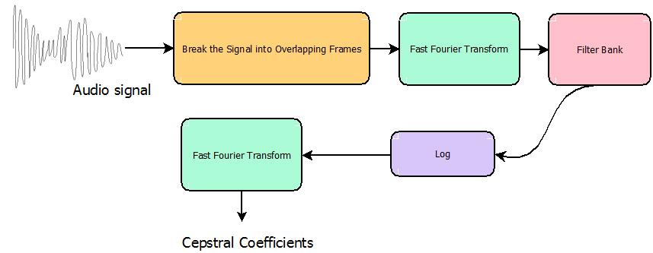
MFCC feature extraction

Slide 9
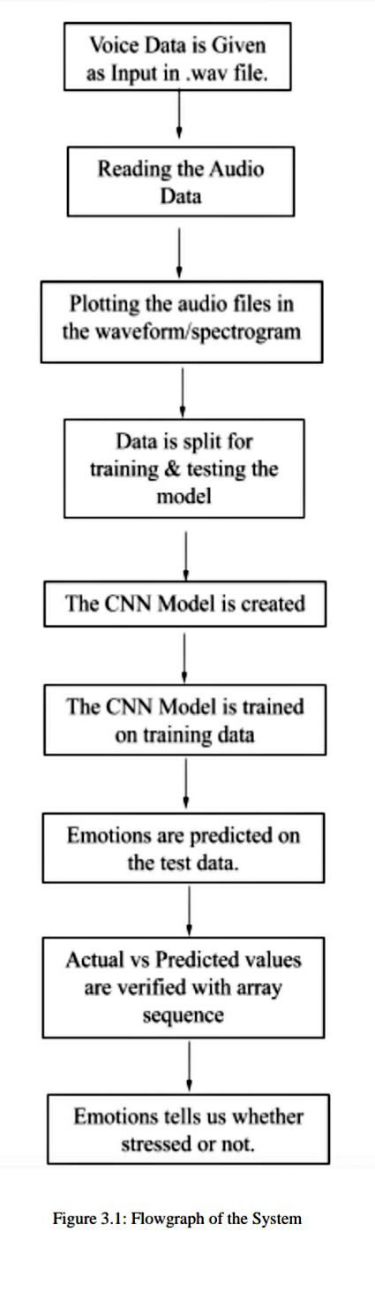
The speech features (i.e., mel-filterbank coefficients) obtained in the feature extraction module are passed to a deep-learning based stress detection model. The CNN structure determines the user’s stress state by a hard decision process.

Slide 10
CONCLUSION:
To detect the stressed state using only speech signals, we used audio data through a multi-step process and established stress-detection models using deep learning frameworks using an CNN structure.

